Slide 1
EDUC 200C
week10
December 7, 2012

Slide 2
Two main ideas…
Describing a sample
  Individual variables (mean and spread of data)
  Relationships between two variables (correlation)
Making inferences about the population from the sample
  One sample (t-test)
  Two samples (t-test)
  Two or more samples (ANOVA)

Slide 3
Describing a sample

Slide 4
Describing a sample
Individual variables
  Central tendency
    Mean, median, mode
  Variability
    Spread of observations around the mean
    Variance
    Standard deviation

Slide 5
Describing a sample
Relative position
  z scores
  Data transformation to give data a mean on 0 and a standard deviation of 1

Slide 6
Describing a sample
The relationship between two ore more variables
  Measure of the strength of relationship
  Pearson correlation (between two continuous variables)
    Z-score difference formula
    Z-score product formula
    Raw score formula
  Spearman rank-order correlation coefficient (two rank order variables)

Slide 7
Describing a sample
Regression
  Predict Y from X:
  Error (or residual):
  Standard error:
  r-squared:

Slide 8
Inference

Slide 9
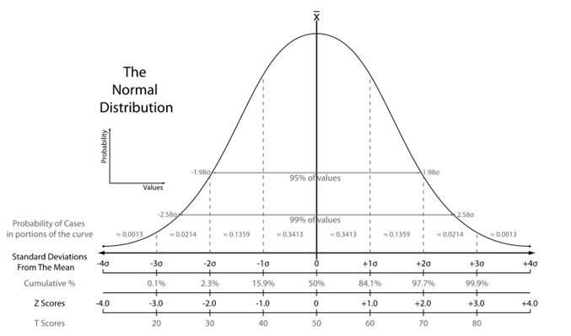
The Normal Distribution

Slide 10
Inference
Type I and Type II error
 | H₀ True | H₀ False
Reject H₀ | Type I error α | Correct! Power: 1-β
Retain H₀ | Correct! Confidence: 1-α | Type II error β

Slide 11
Inference
Power reflects our ability to correctly reject the null hypothesis when it is false
Must have a specific alternative hypothesis in mind
  Alternatively, we can specify a target power level and, with a particular sample size determine how big of an effect we will be able to detect
We have higher power with larger samples and when testing for large effect sizes
There is a tradeoff between α and power

Slide 12
Inference
One Sample
  H₀: μ=some number
  Population standard deviation (σ) known
    Standard error:
    Compare to normal distribution
    Confidence interval:
  Population standard deviation not known
    Standard error:
    Compare to t distribution
    Confidence interval:

Slide 13
Inference
Two samples
  Independent samples
    H₀: μ₁= μ₂
    Pooled variance:
    Standard error:
    Confidence interval:

Slide 14
Inference
Matched pairs
  H₀: μ_{D}=0
  Standard error:
  Compare to t distribution

Slide 15
Inference
More than two samples
  Compare to F distribution
  One-way ANOVA
    H₀: μ₁= μ₂ =…= μ_{k}
  Two-way ANOVA (factorial design)
    H₀: μ_{a1}= μ_{a2} =…= μ_{aj}
      μ_{b1}= μ_{b2} =…= μ_{bl}
      μ_{axb1}= μ_{axb2} =…= μ_{axbk}
  Degrees of freedom will vary with number of groups and levels within factors

Slide 16
Concept Map: Descriptive

Slide 17
Concept Map: Inferential

Slide 18
Final Exam will be posted tomorrow on Coursework…due December 14.
(I’ll send out an email to let you know it’s there.)
Thanks for a great quarter!!

